Slide 1
Energy Demand Forecasting
Unleash the power of foresight.

Slide 2
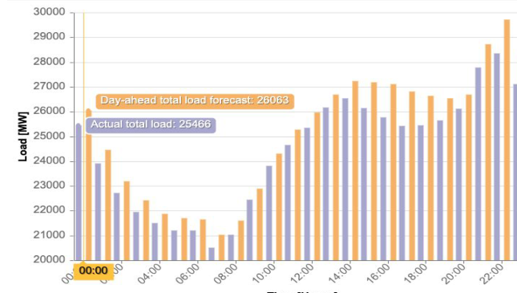
What is Short term energy forecasting
01
03
Timeframe
Factors
Focuses on predicting energy demand for the next few hours, days, or weeks.
Considers things that impact short-term fluctuations like weather, holidays, and historical consumption data.
02
04
Applications
Goal
Helps manage real-time grid operations, power plant scheduling, and energy trading.
Ensures enough energy is available to meet peak demand periods and minimizes disruptions.

Slide 3
Models and Data
SARIMA
Holidays data
The science behind smarter short-term energy
Prophet
Energy Data
See the future of energy, today.
LSTIM
Time/Calendar Data
Sequence learning

Slide 4
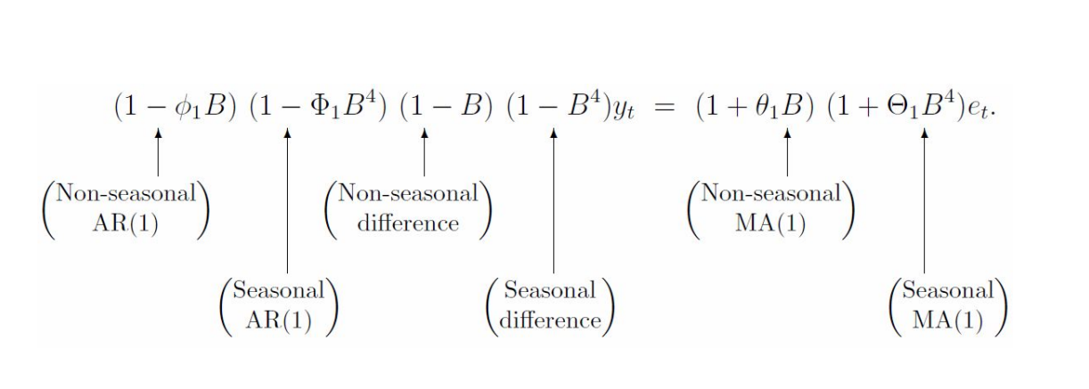
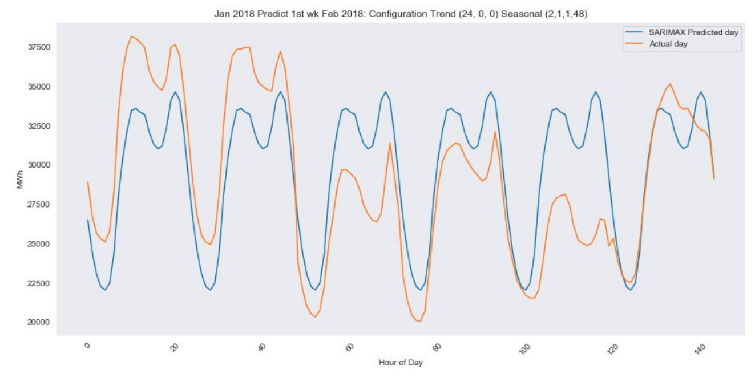
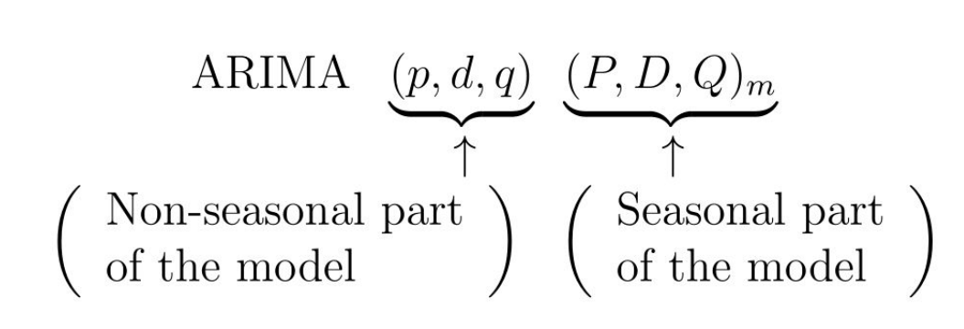
SARIMA(Seasonal AutoRegressive Integrated Moving Average)
The formulas used for our SARIMA

Slide 5
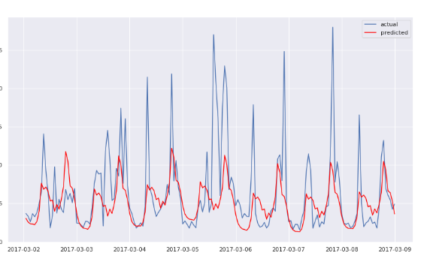
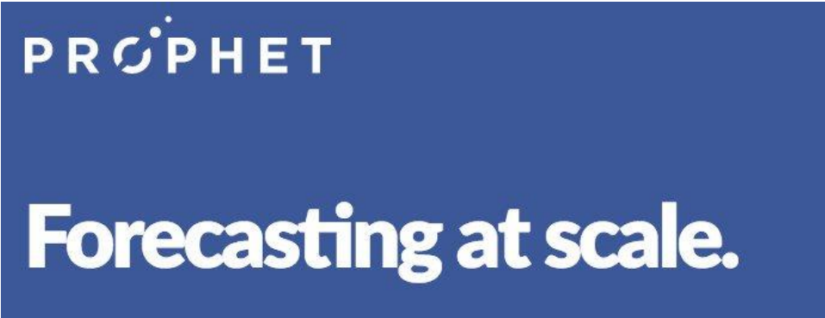
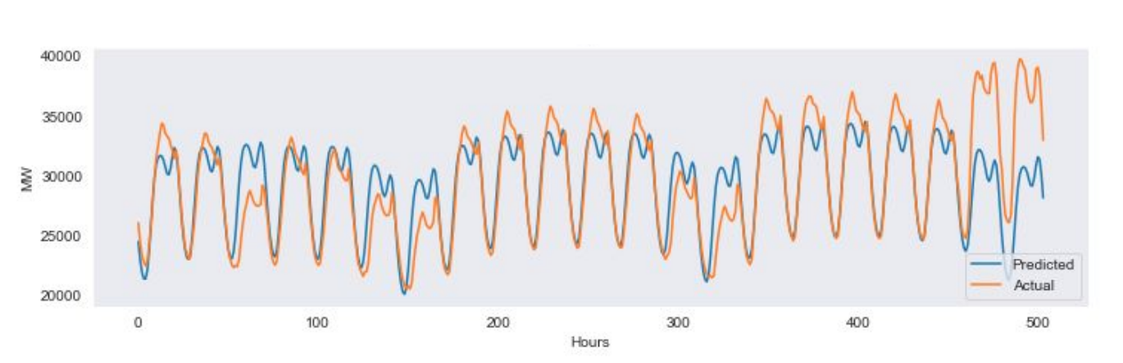
Facebook’s PROPHET

Slide 6
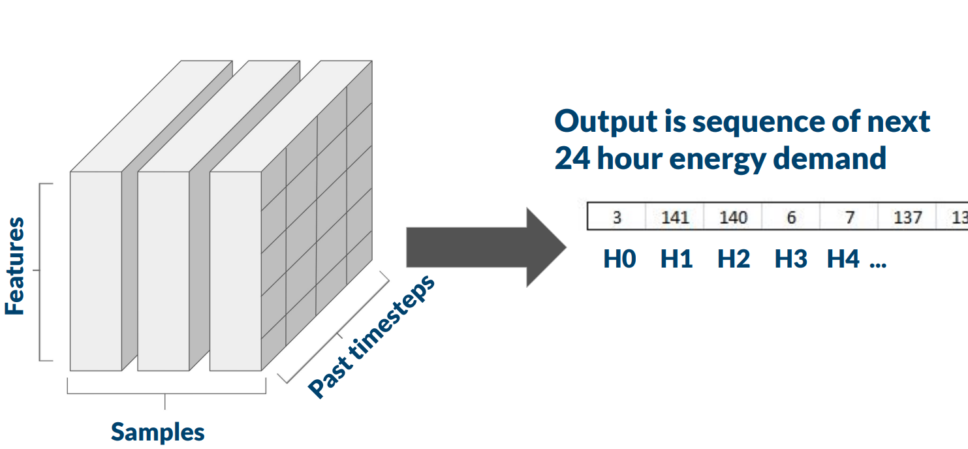
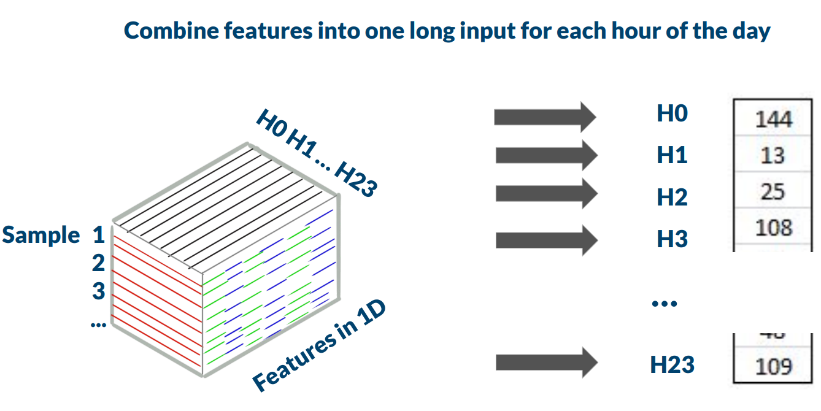
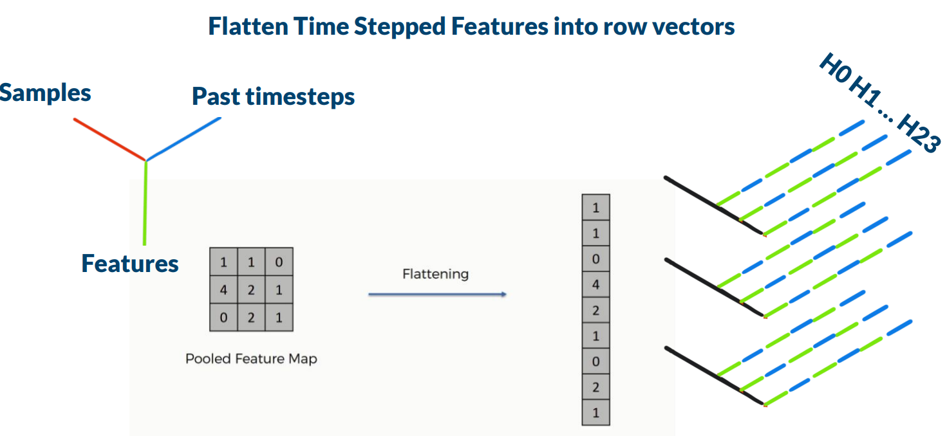
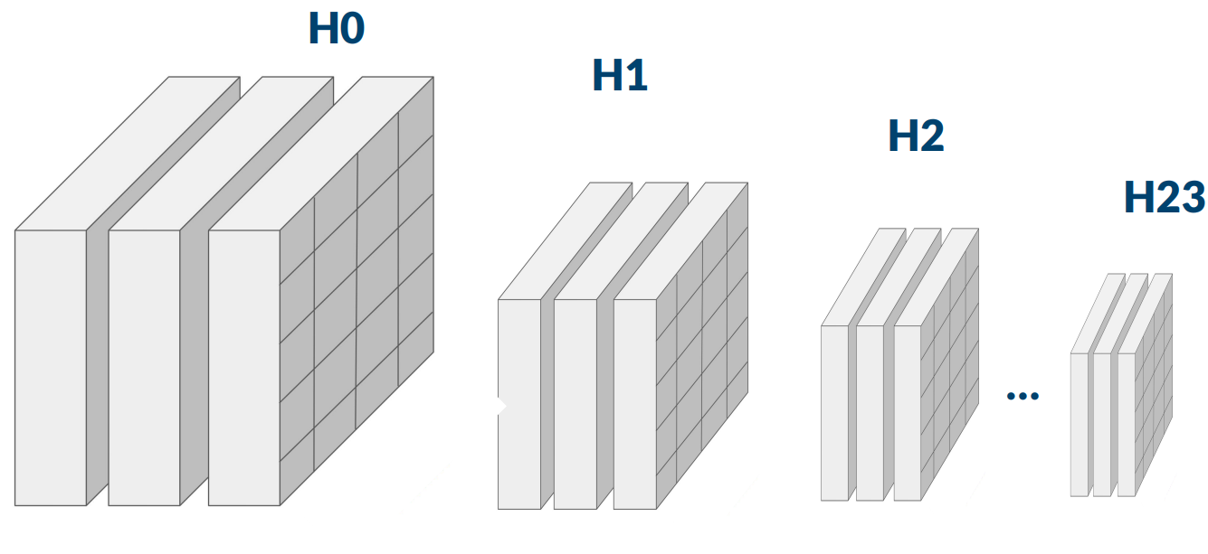
LSTM(Long Short-Term Memory)

Slide 7
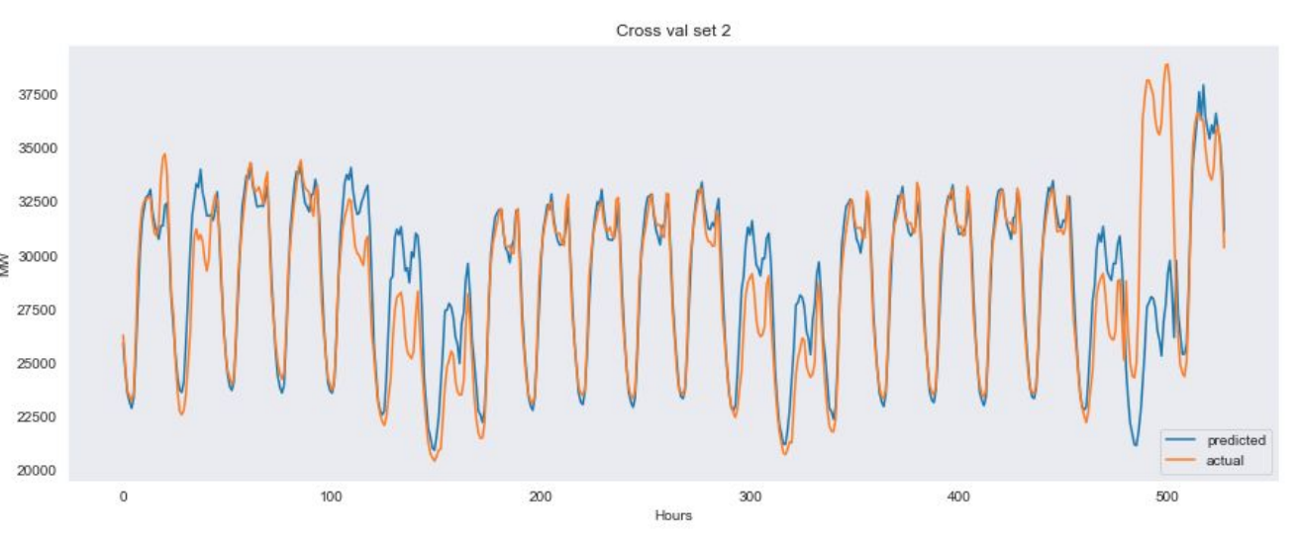
LSTM RESULTS

Slide 8
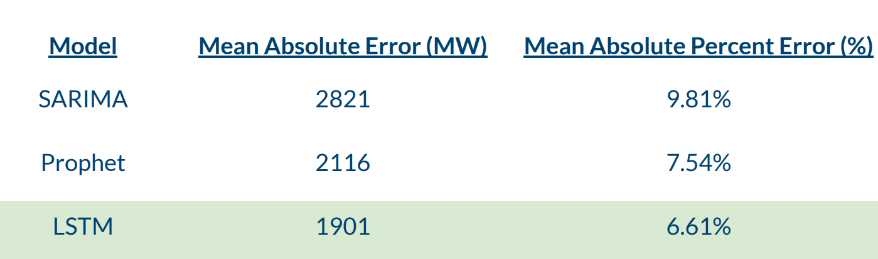
Comparing models

Slide 9
Renewable Energy Infographics
20%
40%
75%
Mercury
Venus
Mars
It’s the closest planet to the Sun and the smallest one in the Solar System
Venus has a beautiful name and is the second planet from the Sun
Despite being red, Mars is actually a cold place. It’s full of iron oxide dust

Slide 10
Renewable Energy Infographics
Mercury
Jupiter
01
04
It’s the closest planet to the Sun
Jupiter is the biggest planet of them all
Venus
Saturn
01
02
05
05
Venus is the second planet from the Sun
It’s composed of hydrogen and helium
02
03
Mars
Neptune
06
03
06
Mars is actually a very cold place
It’s the farthest planet from the Sun
04

Slide 11
Renewable Energy Infographics
Jupiter
Saturn
Neptune
Jupiter is the biggest planet of them all
It’s composed of hydrogen and helium
It’s the farthest planet from the Sun
Paper
95%
Plastic
50%
Glass
80%

Slide 12
What next?
Implementation in more complex models
01
DeepTCN, DSANet, and MTNet
02
03
Incorporate renewable energy generation forecasts
02
01
03
Incorporate external event data and anomaly detection

